Slide 1

Classification
Concepts and Techniques

Slide 2
Classification: Definition
Data is a collection of records (training set)
Each record is by characterized by a tuple (x,y), where x is the attribute set and y is the class label
x: attribute, predictor, independent variable → input
y: class, response, dependent variable → output
Task: Learn a model that maps each attribute set x into one of the predefined class labels
A classification model is an abstract representation of the relationship between the attribute set and the class label

Slide 3
Examples of Classification Task
Binary classification
problems, in which each data instance can be categorized into one of two classes
Multiclass classification
problems, in which each data instance can be categorized into one of multiple classes
Task | Attribute set (x) | Class label (y) | Classification type
Categorizing email messages | Features extracted from email message header and content | spam or non-spam | Binary
Identifying tumor cells | Features extracted from x-rays or MRI scans | malignant or benign cells | Binary
Cataloging galaxies | Features extracted from telescope images | Elliptical, spiral, or irregular-shaped galaxies | Multiclass

Slide 4
Classification Models
Roles of Classification Models:
Predictive Model: Classifies previously unlabeled instances.
Descriptive Model: Identifies distinguishing characteristics between different classes.
Example: Medical diagnosis, where justifying predictions is crucial.
Key Requirements:
Accuracy: Predict outcomes correctly.
Efficiency: fast response times.

Slide 5
General Framework for Classification
Key Concepts:
Classifier: A model used to perform classification.
Training Set: A set of instances with attribute values and class labels used to build the model.
Learning Algorithm: The systematic approach used to create the model from the training set. This process is called Induction (learning/building a model).
Deduction: Applying the learned model to new, unseen test instances to predict their class labels.
Steps in Classification:
Induction (training): Learn the model from training data.
Deduction (inference): Apply the model to classify new instances.

Slide 6
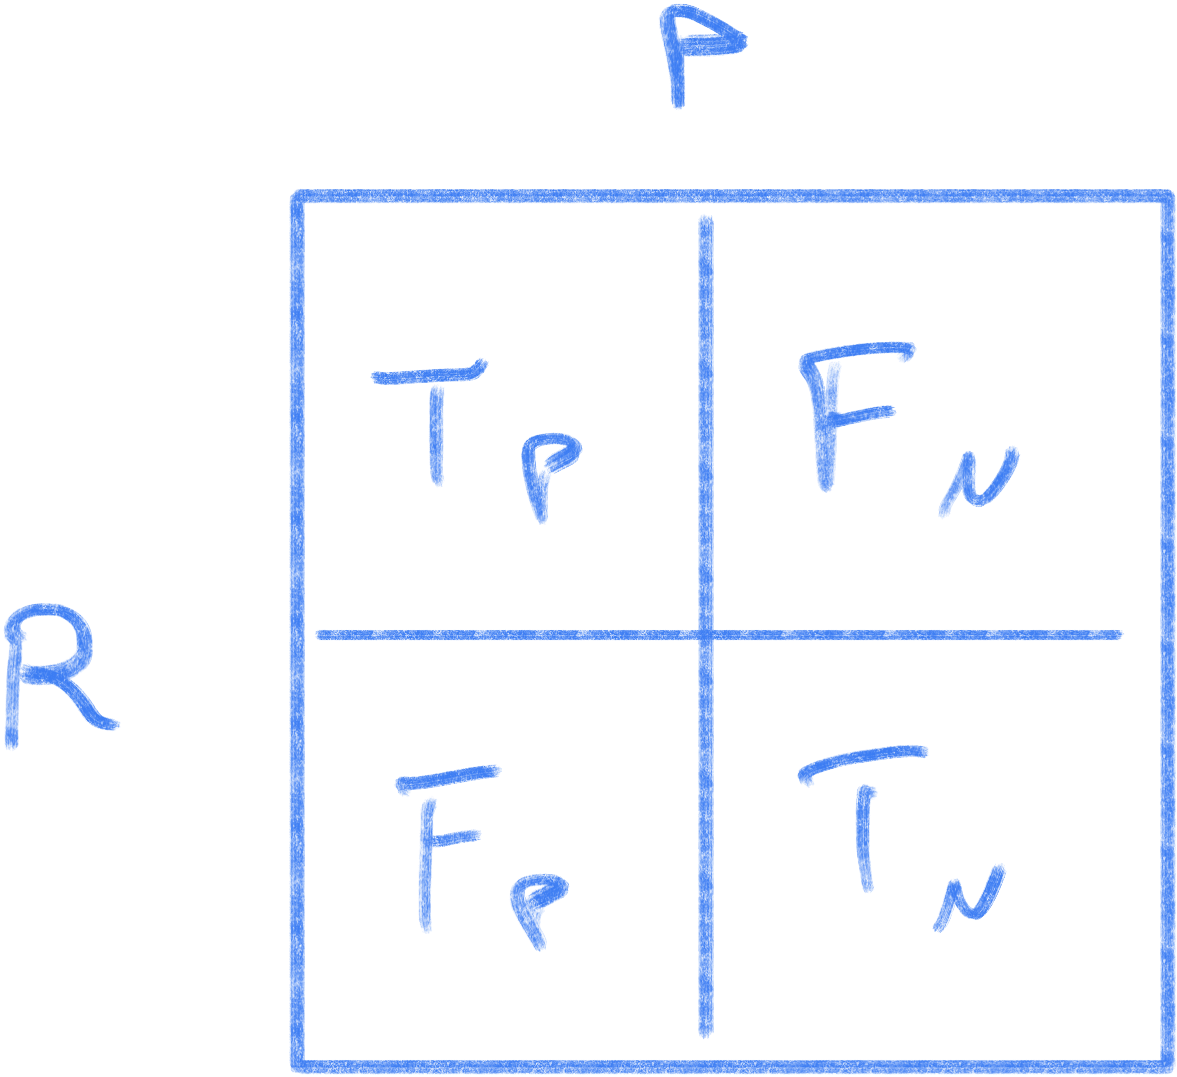
Classification performance
Pivotal concepts
Independence of Training and Test Sets: Ensures the model can predict class labels for unseen instances.
Generalization Performance: A model with good generalization can accurately predict labels for new, unseen data.
Model Performance Evaluation: Compare predicted labels against true labels to evaluate accuracy.
Model Performance Evaluation: Compare predicted labels against true labels to evaluate accuracy.
Confusion Matrix
Accuracy: number of correct over total
Error Rate: number of wrong over total

Slide 7
Classification Techniques
Base Classifiers
Decision Tree based Methods
Nearest-neighbor
Naïve Bayes and Bayesian Belief Networks
Support Vector Machines
Neural Networks, Deep Neural Nets
Ensemble Classifiers
Boosting, Bagging, Random Forests

Slide 8
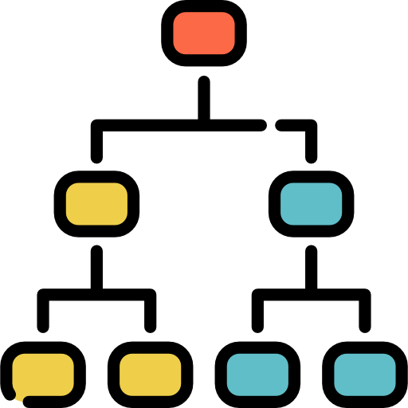
Decision Tree
Decision
Tree

Slide 9

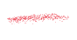



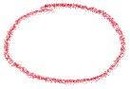

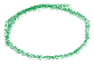
Decision Tree
A decision tree is a supervised machine learning algorithm used for both classification and regression tasks. It models decisions and their possible consequences in a tree-like structure, where:
Root node: node with no incoming link
Nodes: represent decisions or tests on attributes (features).
Edges: represent the outcome of the test, leading to either more nodes or leaf nodes.
Leaf or terminal nodes: represent the final outcome or class label in classification tasks.
The tree is built by splitting the data based on feature values that best separate the classes or predict the target variable.
The goal is to create a tree that accurately classifies new instances by following the decision rules in the tree structure.
Home Owner
Yes
No
NO
MarSt
Single, Divorced
Married
Income
NO
< 80K
> 80K
NO
YES

Slide 10
Example of a Decision Tree
categorical
categorical
continuous
class
Splitting Attributes
Home Owner
Yes
No
NO
MarSt
Single, Divorced
Married
Income
NO
< 80K
> 80K
NO
YES
Training Data
Model: Decision Tree

Slide 11
Apply Model to Test Data
Test Data
Start from the root of tree.
Home Owner
Yes
No
NO
MarSt
Single, Divorced
Married
Income
NO
< 80K
> 80K
NO
YES

Slide 12
Apply Model to Test Data
Test Data
Home Owner
Yes
No
NO
MarSt
Single, Divorced
Married
Income
NO
< 80K
> 80K
NO
YES

Slide 13
Apply Model to Test Data
Test Data
Home Owner
Yes
No
NO
MarSt
Single, Divorced
Married
Income
NO
< 80K
> 80K
NO
YES

Slide 14
Apply Model to Test Data
Test Data
Home Owner
Yes
No
NO
MarSt
Single, Divorced
Married
Income
NO
< 80K
> 80K
NO
YES

Slide 15
Apply Model to Test Data
Test Data
Home Owner
Yes
No
NO
MarSt
Single, Divorced
Married
Income
NO
< 80K
> 80K
NO
YES

Slide 16
Apply Model to Test Data
Test Data
Home Owner
Yes
No
NO
MarSt
Single, Divorced
Married
Assign Defaulted to “No”
Income
NO
< 80K
> 80K
NO
YES

Slide 17
Another Example of Decision Tree
categorical
categorical
continuous
class
Single, Divorced
MarSt
Married
NO
Home Owner
Yes
No
NO
Income
< 80K
> 80K
NO
YES
There could be more than one tree that fits the same data!

Slide 18
Decision Tree Induction
Many Algorithms:
Hunt’s Algorithm (one of the earliest)
CART
ID3, C4.5
SLIQ,SPRINT

Slide 19
General Structure of Hunt’s Algorithm
Let D_{t} be the set of training records that reach a node t
General Procedure:
If D_{t} contains records that belong the same class y_{t}, then t is a leaf node labeled as y_{t}
If D_{t} contains records that belong to more than one class, use an attribute test to split the data into smaller subsets. Recursively apply the procedure to each subset.
D_{t}
?

Slide 20
Hunt’s Algorithm
Defaulted
(7,3)
(no, yes)
Defaulted
Defaulted
(3,0)
(no, yes)
(4,3)
(no, yes)
Defaulted
(3,0)
(no, yes)
Defaulted
(3,0)
(no, yes)
Defaulted
(3,0)
(no, yes)
Defaulted
Defaulted
(1,3)
(no, yes)
(3,0)
(no, yes)
Defaulted
Defaulted
(1,0)
(no, yes)
(0,3)
(no, yes)

Slide 21
Hunt’s Algorithm
Defaulted
(7,3)
(no, yes)
Defaulted
Defaulted
(3,0)
(no, yes)
(4,3)
(no, yes)
Defaulted
(3,0)
(no, yes)
Defaulted
(3,0)
(no, yes)
Defaulted
(3,0)
(no, yes)
Defaulted
Defaulted
(1,3)
(no, yes)
(3,0)
(no, yes)
Defaulted
Defaulted
(1,0)
(no, yes)
(0,3)
(no, yes)

Slide 22
Hunt’s Algorithm
Defaulted
(7,3)
(no, yes)
Defaulted
Defaulted
(3,0)
(no, yes)
(4,3)
(no, yes)
Defaulted
(3,0)
(no, yes)
Defaulted
(3,0)
(no, yes)
Defaulted
(3,0)
(no, yes)
Defaulted
Defaulted
(1,3)
(no, yes)
(3,0)
(no, yes)
Defaulted
Defaulted
(1,0)
(no, yes)
(0,3)
(no, yes)

Slide 23
Hunt’s Algorithm
Defaulted
(7,3)
(no, yes)
Defaulted
Defaulted
(3,0)
(no, yes)
(4,3)
(no, yes)
Defaulted
(3,0)
(no, yes)
Defaulted
(3,0)
(no, yes)
Defaulted
(3,0)
(no, yes)
Defaulted
Defaulted
(1,3)
(no, yes)
(3,0)
(no, yes)
Defaulted
Defaulted
(1,0)
(no, yes)
(0,3)
(no, yes)

Slide 24
Design Issues of Decision Tree Induction
How should training records be split?
Method for expressing test condition depending on attribute types
Measure for evaluating the goodness of a test condition
How should the splitting procedure stop?
Stop splitting if all the records belong to the same class or have identical attribute values
Early termination

Slide 25
Methods for Expressing Test Conditions
Depends on attribute types
Binary
Nominal
Ordinal
Continuous

Slide 26
Test Condition for Nominal Attributes
Multi-way split:
Use as many partitions as distinct values.
Binary split:
Divides values into two subsets

Slide 27
Test Condition for Ordinal Attributes
Multi-way split:
Use as many partitions as distinct values
Binary split:
Divides values into two subsets
Preserve order property among attribute values
This grouping violates order property !

Slide 28
Test Condition for Continuous Attributes

Slide 29
Splitting Based on Continuous Attributes
Different ways of handling
Discretization to form an ordinal categorical attribute
Ranges can be found by equal interval bucketing, equal frequency bucketing (percentiles), or clustering.
Static – discretize once at the beginning
Dynamic – repeat at each node
Binary Decision: (A < v) or (A ≥ v)
consider all possible splits and finds the best cut
can be more compute intensive

Slide 30
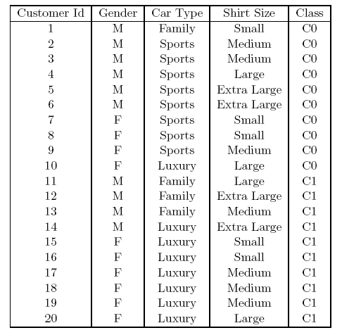
How to determine the Best Split
Goodness of an attribute test condition: many measures try to give preference to attribute test conditions that partition the training instances into purer subsets in the child nodes, which mostly have the same class labels
Before Splitting: 10 records of class 0, 10 records of class 1
Which test condition is the best?
NOTE: Larger trees are less desirable as they are more susceptible to model overfitting

Slide 31
How to determine the Best Split
Goodness of an attribute test condition: many measures try to give preference to attribute test conditions that partition the training instances into purer subsets in the child nodes, which mostly have the same class labels
Before Splitting: 10 records of class 0, 10 records of class 1
Which test condition is the best?
NOTE: Larger trees are less desirable as they are more susceptible to model overfitting

Slide 32
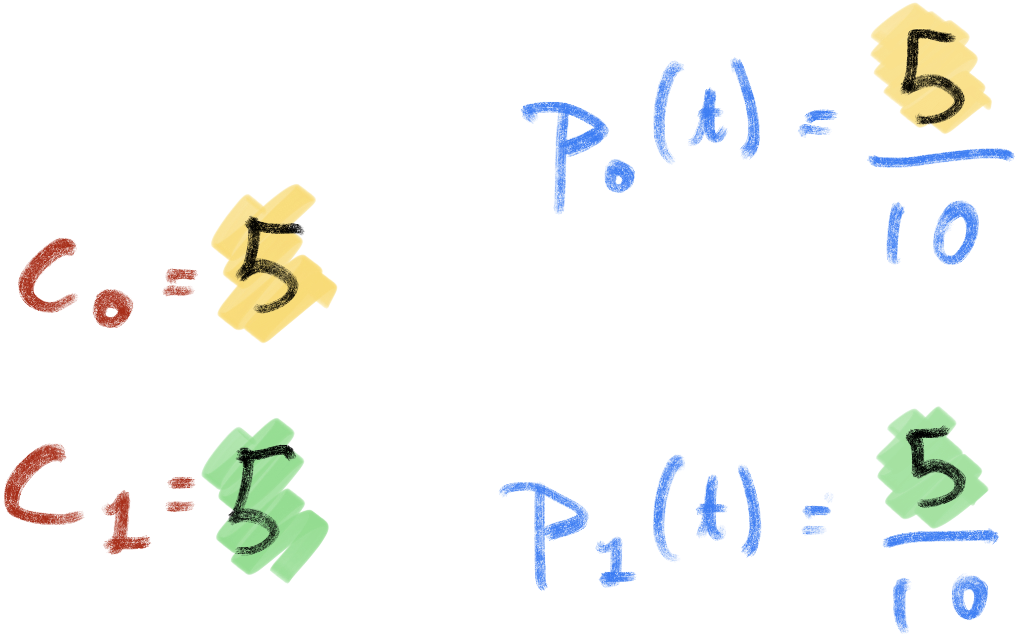
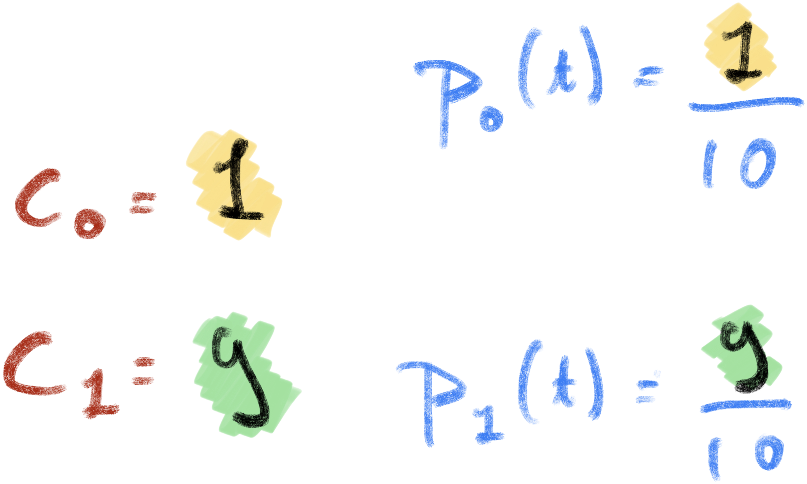
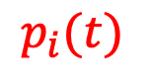
How to determine the Best Split
Greedy approach: Nodes with purer class distribution are preferred
We need a measure of node impurity !
Let’s define the RELATIVE FREQUENCY
High degree of impurity
Low degree of impurity
$$p_{i}(t)$$

Slide 33
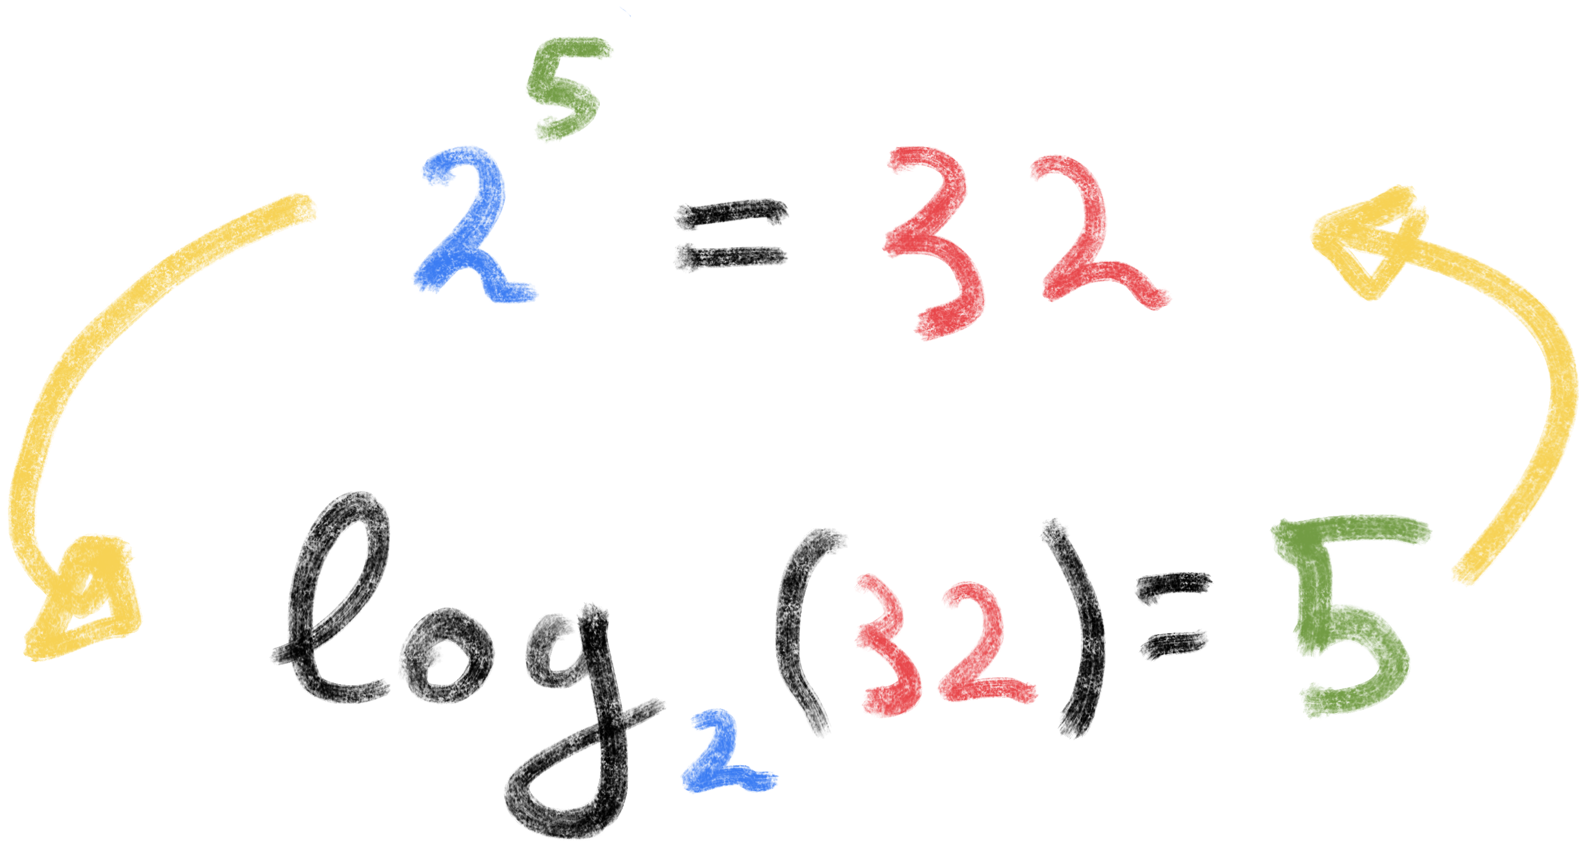
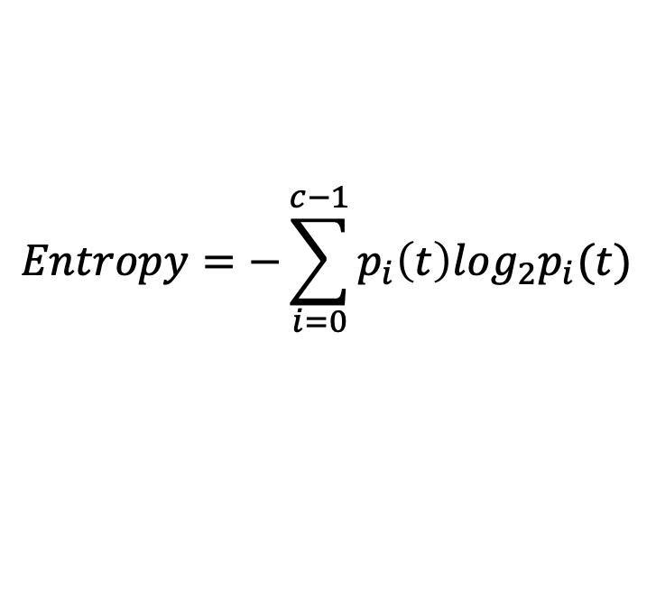
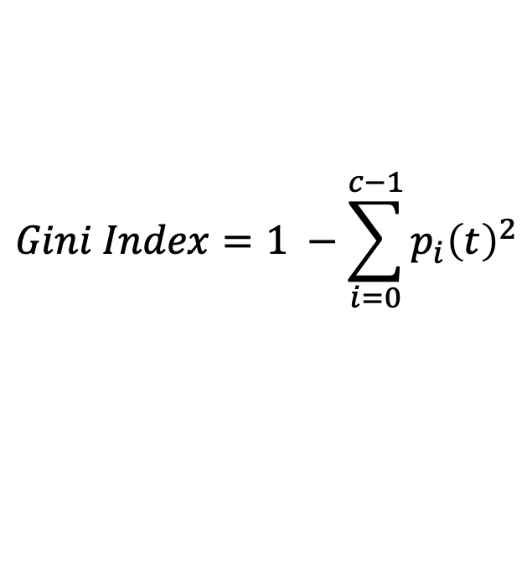
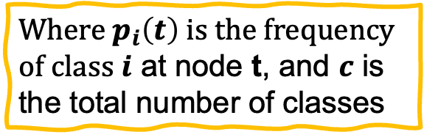
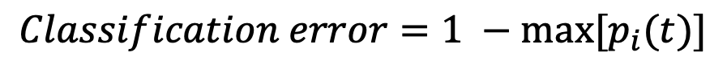
Measures of Single Node Impurity
Gini Index
Entropy
Misclassification error
$$Gini Index=1 −\sum_{i=0}^{c−1}{p_{i}{\left(t\right)}^{2}}$$
Where $p_{i}\left(t\right)$ is the frequency of class $i$ at node t, and $c$ is the total number of classes
$$Entropy=−\sum_{i=0}^{c−1}{p_{i}\left(t\right)log_{2}p_{i}(t)}$$
$$Classification error={1 −max⁡[p}_{i}(t)]$$

Slide 34
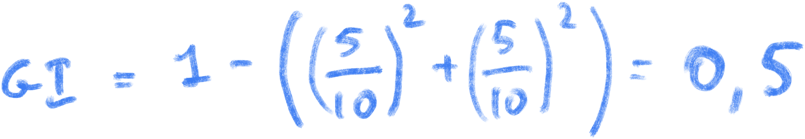
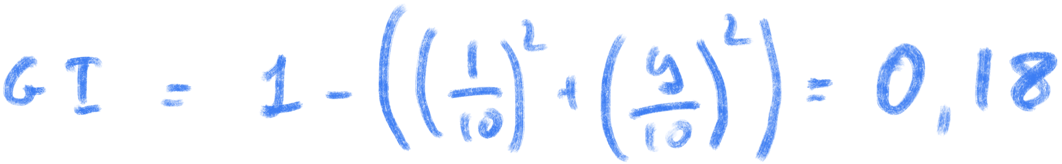
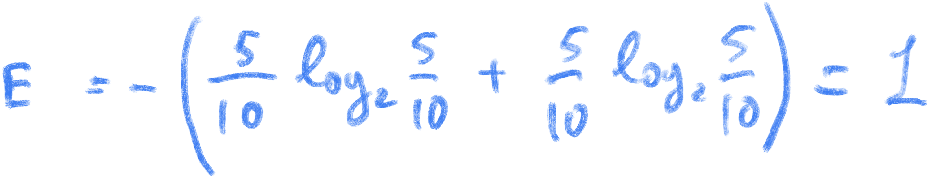
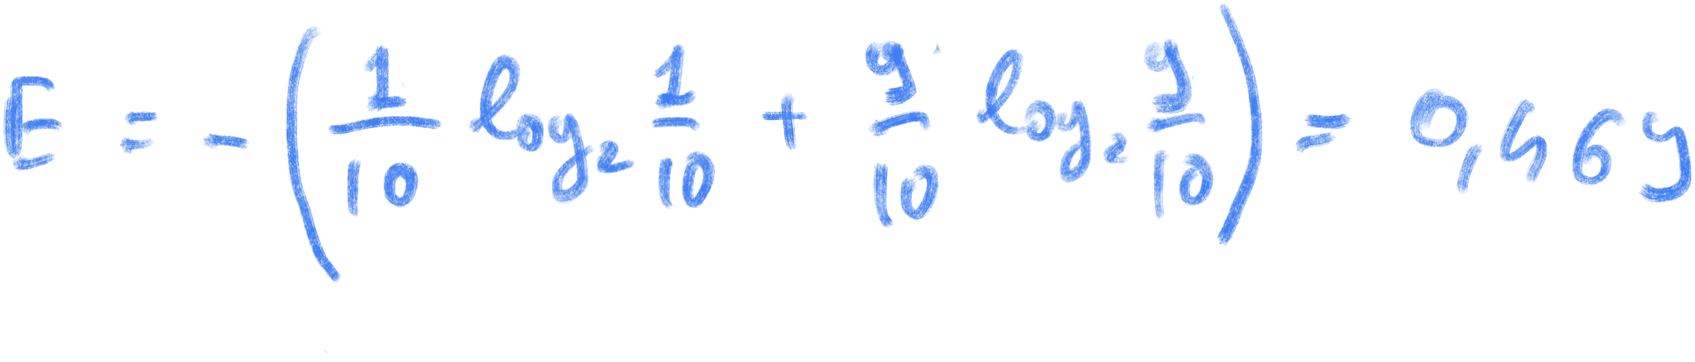
Compute Single Node Impurity
High degree of impurity
Low degree of impurity

Slide 35
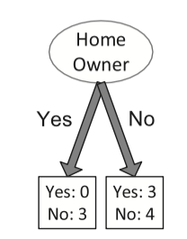
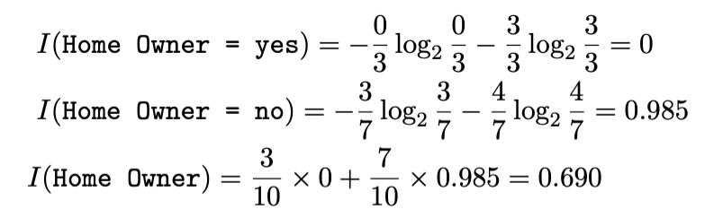
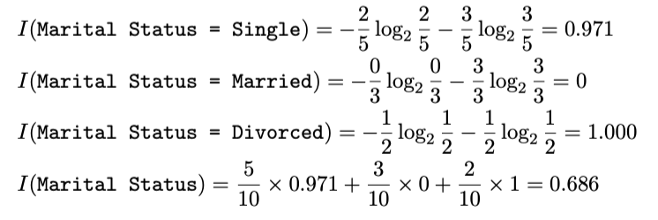
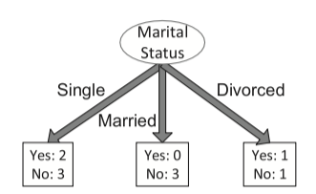
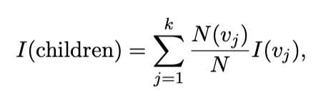
Compute Collective impurity of Child nodes
Once a decision rule attribute test condition have been applied it is possible to compute the collective impurity of child nodes
Consider an attribute test condition that splits a node containing N training instances into k children, {v1, v2, · · · , vk}
Let N(vj) be the number of training instances associated with a child node vj, whose impurity value is I(vj)
The weighted impurity measure of its children

Slide 36
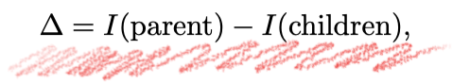
Finding the Best Split
Compute impurity measure I(parent) before splitting
Compute impurity measure I(children) after splitting
Compute impurity measure of each child node
I(children) is the weighted impurity of child nodes
Choose the attribute test condition that produces the highest gain
or equivalently, lowest impurity measure after splitting

Slide 37
Finding the Best Split
Parent
P
Candidate Split
A
B
Yes
No
Yes
No
Node N1
Node N2
Node N1
Node N2
Candidate Children
MA1 = Gini_Index (A, N1)
MA2 = Gini_Index (A, N2)
MB1 = Gini_Index (B, N1)
MB2 = Gini_Index (B, N2)
M A
M B
Gain A = P – M A vs Gain B = P – M B

Slide 38
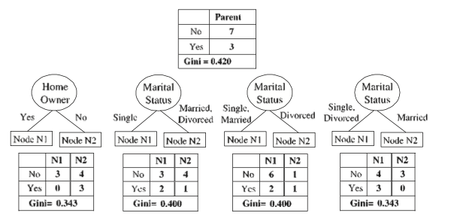
Finding the Best Split
It can be shown that the gain is non-negative since I(parent) ≥ I(children) for any reasonable measure
The higher the gain, the purer are the classes in the child nodes relative to the parent node.
The splitting criterion in the decision tree learning algorithm selects the attribute test condition that shows the maximum gain (minimizing the weighted impurity measure of its children)
Home Owner and Marital Status (with the highlited association) shows the minimum weighted impurity
N(vj): number of training instances associated with the child node vj

Slide 39
Binary Attributes: Computing GINI Index
Splits into two partitions (child nodes)
Effect of Weighing partitions:
Larger and purer partitions are sought
B?
Yes
No
Node N1
Node N2
Gini(N1) = 1 – (5/6)² – (1/6)² = 0.278
Gini(N2) = 1 – (2/6)² – (4/6)² = 0.444
Weighted Gini of N1 N2 = 6/12 * 0.278 + 6/12 * 0.444 = 0.361
Gain = 0.486 – 0.361 = 0.125

Slide 40
Categorical Attributes: Computing Gini Index
For each distinct value, gather counts for each class in the dataset
Multi-way split
Two-way split
(find best partition of values)
Which of these is the best?

Slide 41
Continuous Attributes: Computing Gini Index
Use Binary Decisions based on one value
Several Choices for the splitting value
Number of possible splitting values = Number of distinct values
Each splitting value has a count matrix associated with it
Class counts in each of the partitions, A ≤ v and A > v
Simple method to choose best v
For each v, scan the database to gather count matrix and compute its Gini index
Computationally Inefficient! Repetition of work.
Annual Income ?
 | ≤ 80 | > 80
Defaulted Yes | 0 | 3
Defaulted No | 3 | 4

Slide 42
Continuous Attributes: Computing Gini Index
For efficient computation: for each attribute,
Sort the attribute on values
Linearly scan these values, each time updating the count matrix and computing gini index
Choose the split position that has the least gini index
Sorted Values

Slide 43
Continuous Attributes: Computing Gini Index
For efficient computation: for each attribute,
Sort the attribute on values
Linearly scan these values, each time updating the count matrix and computing gini index
Choose the split position that has the least gini index
Sorted Values
Split Positions

Slide 44
Continuous Attributes: Computing Gini Index
For efficient computation: for each attribute,
Sort the attribute on values
Linearly scan these values, each time updating the count matrix and computing gini index
Choose the split position that has the least gini index
Sorted Values
Split Positions

Slide 45
Continuous Attributes: Computing Gini Index
For efficient computation: for each attribute,
Sort the attribute on values
Linearly scan these values, each time updating the count matrix and computing gini index
Choose the split position that has the least gini index
Sorted Values
Split Positions

Slide 46
Continuous Attributes: Computing Gini Index
For efficient computation: for each attribute,
Sort the attribute on values
Linearly scan these values, each time updating the count matrix and computing gini index
Choose the split position that has the least gini index
Sorted Values
Split Positions

Slide 47
Problem with large number of partitions
Node impurity measures tend to prefer splits that result in large number of partitions, each being small but pure
Customer ID has highest information gain because Gini or Entropy is 0 for all the children

Slide 48
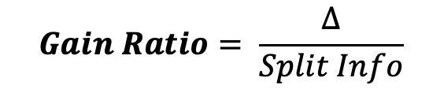
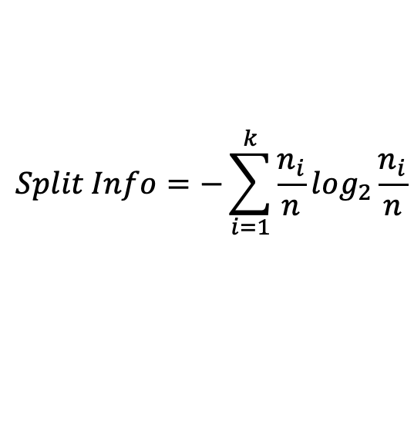
Gain Ratio
The number of children produced by the splitting attribute must be taken into consideration while deciding the best attribute test condition
A measure known as Gain Ratio is used to compensate for attributes that produce a large number of child nodes
The Split Information measures the entropy of splitting a node into its child nodes and evaluates if the split results in a larger number of equally-sized child nodes or not
$$Gain Ratio= \frac{Δ}{Split Info}$$
$$Split Info=−\sum_{i=1}^{k}{\frac{n_{i}}{n}log_{2}}\frac{n_{i}}{n}$$

Slide 49
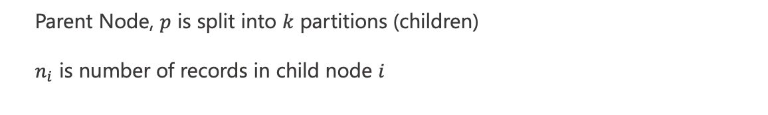
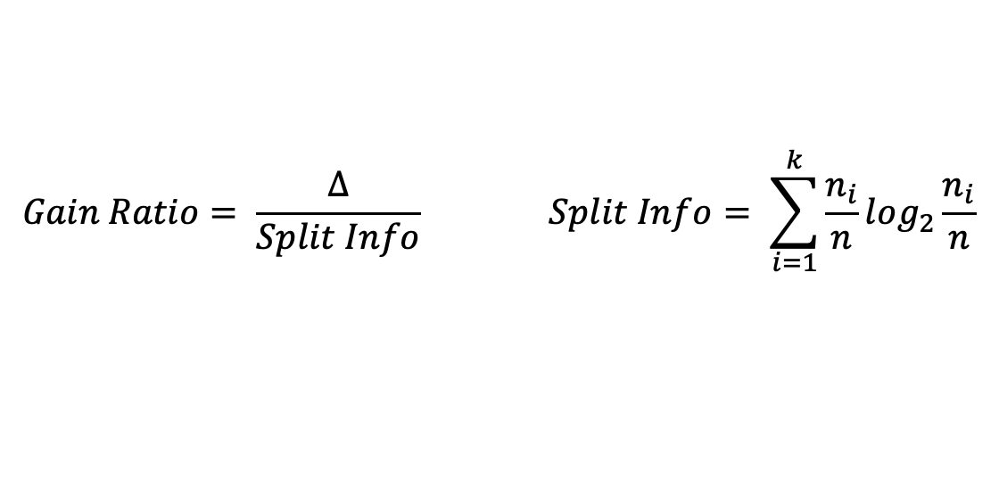
Gain Ratio
$$Gain Ratio= \frac{Δ}{Split Info} Split Info= \sum_{i=1}^{k}{\frac{n_{i}}{n}log_{2}}\frac{n_{i}}{n}$$
SplitINFO = 0.72
SplitINFO = 0.97
SplitINFO = 1.52
Parent Node, $p$ is split into $k$ partitions (children)
$n_{i}$ is number of records in child node $i$

Slide 50
Decision Tree Based Classification
Advantages:
Relatively inexpensive to construct
Extremely fast at classifying unknown records
Easy to interpret for small-sized trees
Robust to noise (especially when methods to avoid overfitting are employed)
Can easily handle redundant attributes
Can easily handle irrelevant attributes (unless the attributes are interacting)
Disadvantages: .
Due to the greedy nature of splitting criterion, interacting attributes (that can distinguish between classes together but not individually) may be passed over in favor of other attributed that are less discriminating.
Each decision boundary involves only a single attribute

Slide 51
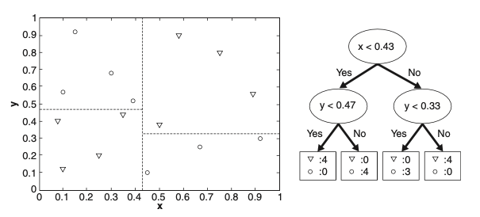
Handling interactions
Rectilinear Decision Boundaries:
Single Attribute Testing: Trees partition the attribute space based on one attribute at a time.
Rectilinear Boundaries: The decision boundary is parallel to coordinate axes.
Limitation: Restricts decision trees in representing complex boundaries, especially with continuous attributes.
Oblique Decision Trees:
Improvement: Allow tests using multiple attributes (e.g., x + y < 20) for more flexible decision boundaries.
Result: Can better represent complex, non-rectilinear boundaries.

Slide 52
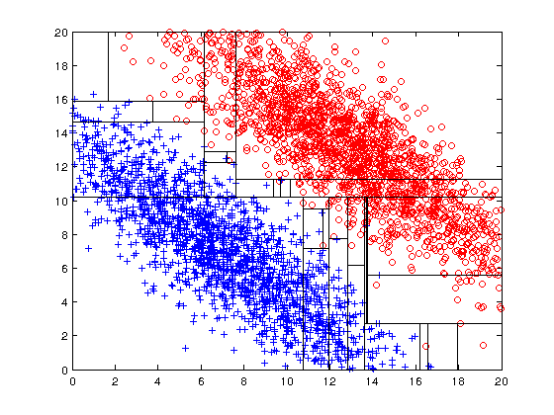
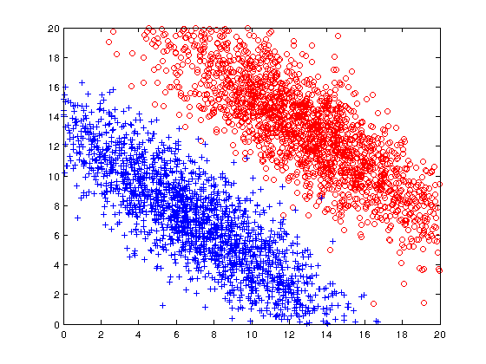
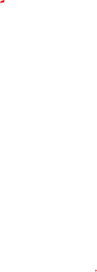
Limitations of single attribute-based decision boundaries

Slide 53
Nearest-Neighbor Classifiers
Nearest-Neighbor
Classifiers

Slide 54
Nearest-Neighbor Classifiers
Basic idea: If it walks like a duck, quacks like a duck, then it’s probably a duck
A nearest neighbor classifier represents each example as a data point in a d-dimensional space (d the number of attributes)
Given a test instance, we compute its proximity to the training instances according to one of the proximity measures
The k-nearest neighbors of a given test instance z refer to the k training examples that are closest to z.
Compute Distance
Test Record
Choose k of the “nearest” records
Training Records

Slide 55
Nearest-Neighbor Classifiers
Requires the following:
A set of labeled records
Proximity metric to compute distance/similarity between a pair of records e.g., Euclidean distance
The value of k, the number of nearest neighbors to retrieve
A method for using class labels of K nearest neighbors to determine the class label of unknown record (e.g., by taking majority vote)

Slide 56
Nearest-Neighbor Classifiers
Choosing the value of k:
If k is too small, sensitive to noise points (overfitting)
If k is too large, neighborhood may include points from other classes
An example of well balanced k

Slide 57
Nearest-Neighbor Classifiers
Choosing the value of k:
If k is too small, sensitive to noise points (overfitting)
If k is too large, neighborhood may include points from other classes
An example of well balanced k
_

Slide 58
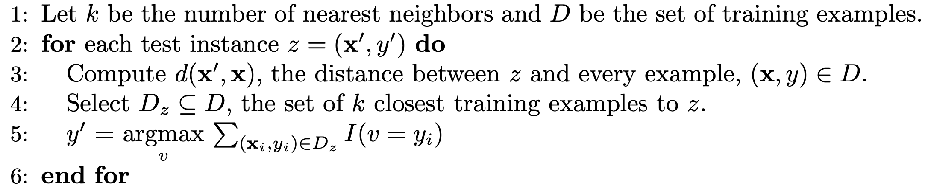
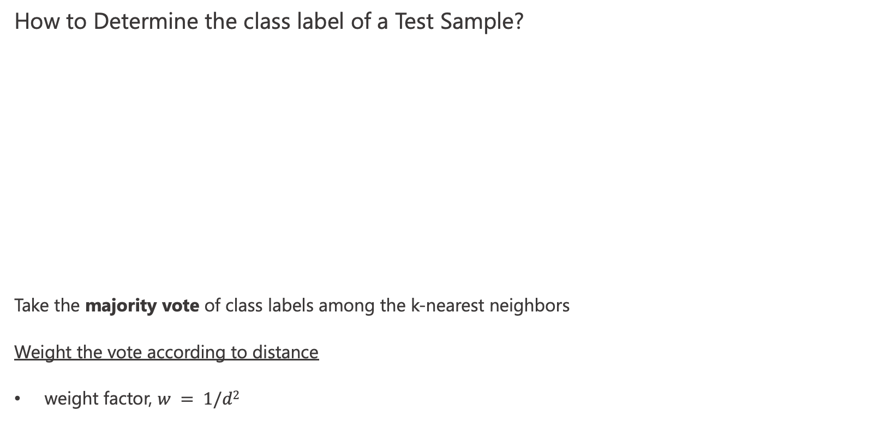
Nearest-Neighbor Classifiers
How to Determine the class label of a Test Sample?
Take the majority vote of class labels among the k-nearest neighbors
Weight the vote according to distance
weight factor, $w = 1/d2$

Slide 59
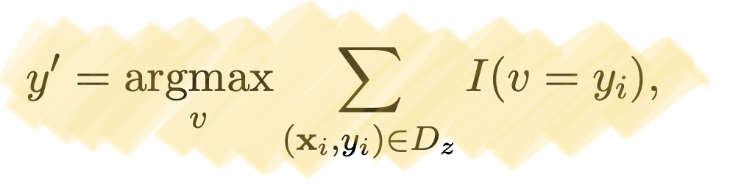
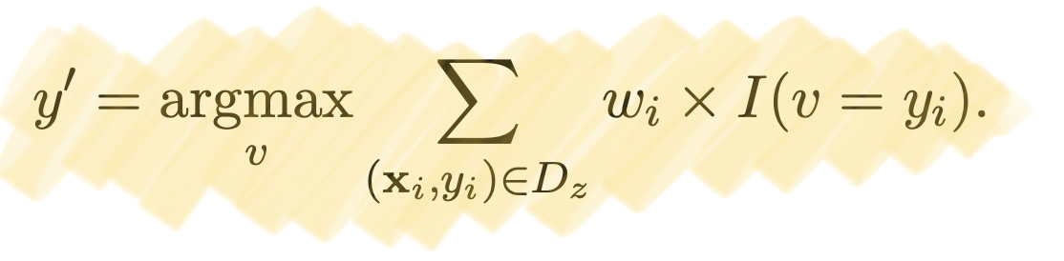
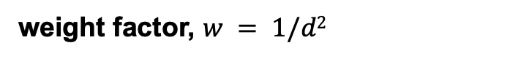
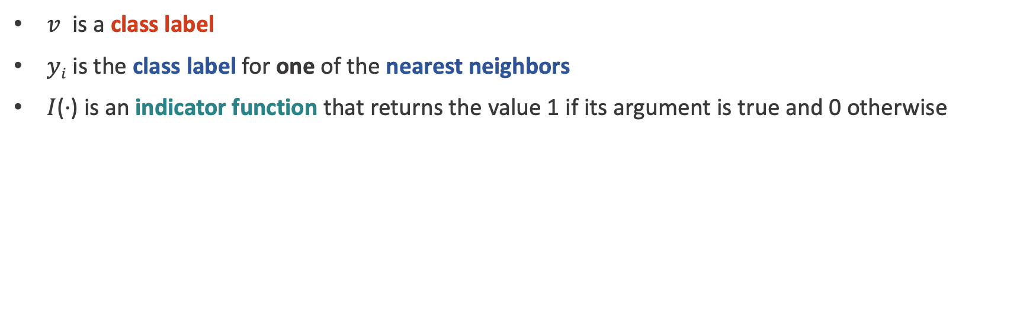
Nearest-Neighbor Classifiers
$v$ is a class label
$yi$ is the class label for one of the nearest neighbors
$I$(·) is an indicator function that returns the value 1 if its argument is true and 0 otherwise
Majority Voting
Distance-Weighted Voting
weight factor, $w = 1/d2$

Slide 60
Nearest-Neighbor Classifiers
Data preprocessing is often required
Attributes may have to be scaled to prevent distance measures from being dominated by one of the attributes
Example:
height of a person may vary from 1.5m to 1.8m
weight of a person may vary from 90lb to 300lb
income of a person may vary from $10K to $1M
It is often useful to standardize data to have 0 means a standard deviation of 1

Slide 61
Nearest-Neighbor Classifiers
How to handle missing values in training and test sets?
Proximity computations normally require the presence of all attributes
Some approaches use the subset of attributes present in two instances
This may not produce good results since it effectively uses different proximity measures for each pair of instances
Thus, proximities are not comparable
How to handle Irrelevant and Redundant Attributes
Irrelevant attributes add noise to the proximity measure
Redundant attributes bias the proximity measure towards certain attributes

Slide 62
Nearest-Neighbor Classifiers
Characteristics
Nearest-Neighbor classification is part of a more general technique known as instance-based learning
Classifying a test instance can be quite expensive because we need to compute the proximity values individually (lazy learners)
Nearest neighbor classifiers can produce decision boundaries of arbitrary shape
Nearest neighbor classifiers have difficulty handling missing values in both the training and test sets since proximity computations normally require the presence of all attributes
The presence of irrelevant attributes can distort commonly used proximity measures, especially when the number of irrelevant attributes is large

Slide 63
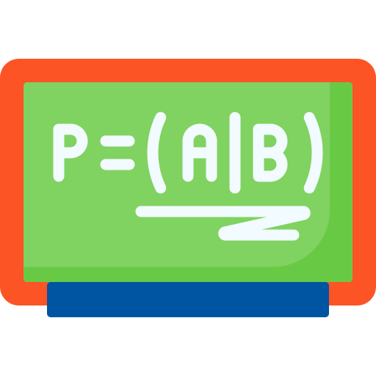
Bayesian Classifiers
Bayesian Classifiers

Slide 64
Bayesian Classifiers
Many classification problems involve uncertainty
Observed attributes and class labels may be unreliable due to imperfections in the measurement process
Set of attributes may not be fully representative of the target class, resulting in uncertain predictions
Classification model learned over a finite training set may not be able to fully capture the true relationships in the overall data
In the presence of uncertainty we need provide predictions of class labels but a measure of confidence
Probability theory offers a systematic way for quantifying and manipulating uncertainty in data
Classification models that make use of probability are known as probabilistic classification model

Slide 65
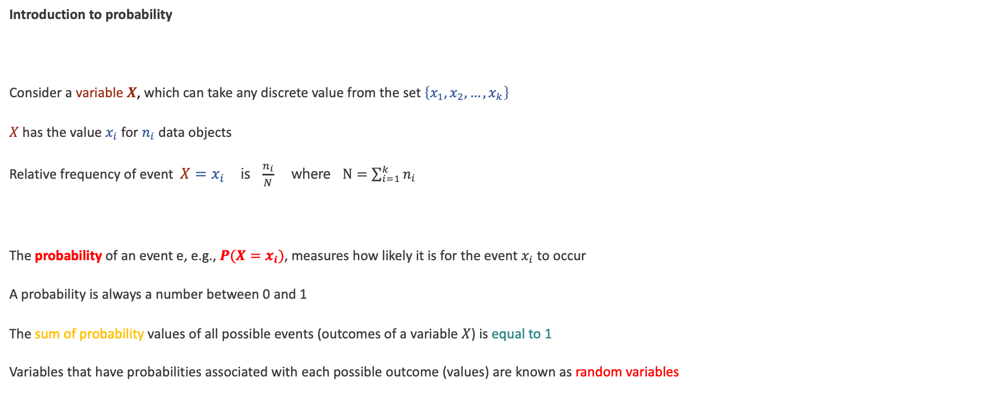
Bayesian Classifiers
Introduction to probability
Consider a variable $X$, which can take any discrete value from the set $\left\{x_{1},x_{2},…, x_{k}\right\}$
$X$ has the value $x_{i}$ for $n_{i}$ data objects
Relative frequency of event ${X=x}_{i}$ is $\frac{n_{i}}{N}$ where $N=\sum_{i=1}^{k}{n_{i}}$
The probability of an event e, e.g., $P(X=x_{i})$, measures how likely it is for the event $x_{i}$ to occur
A probability is always a number between 0 and 1
The sum of probability values of all possible events (outcomes of a variable $X$) is equal to 1
Variables that have probabilities associated with each possible outcome (values) are known as random variables

Slide 66
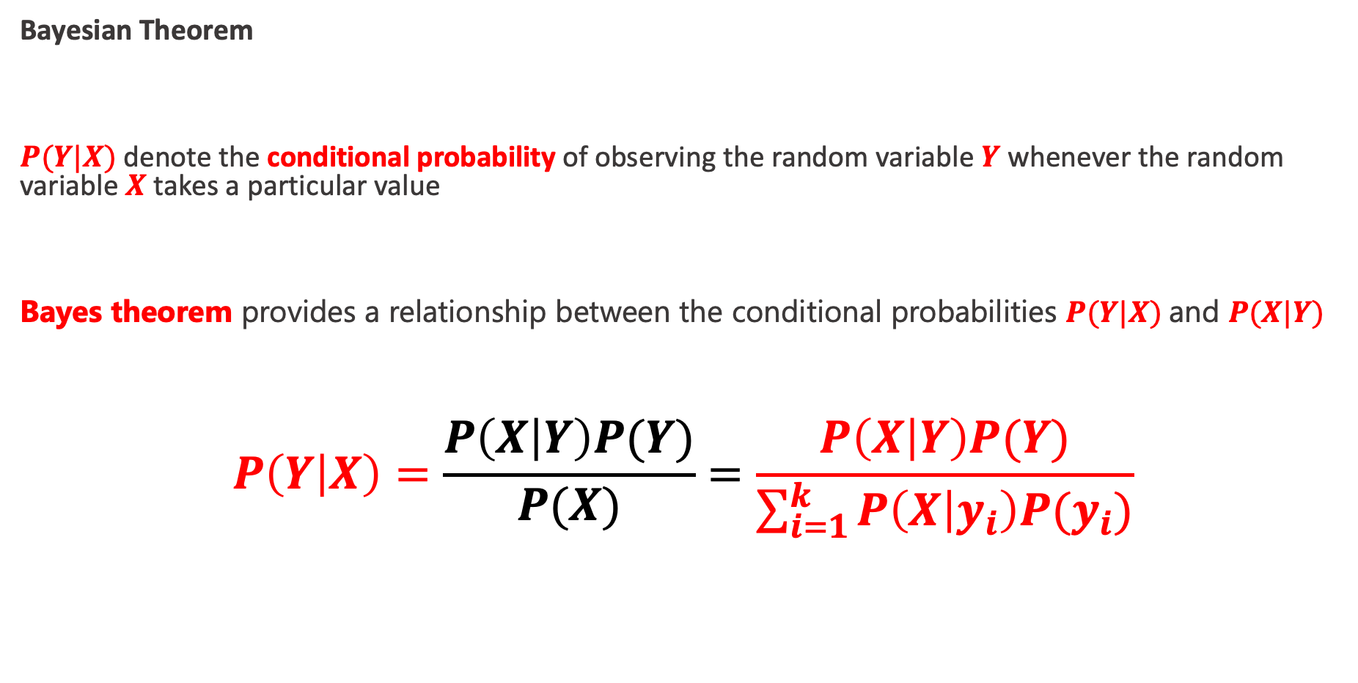
Bayesian Classifiers
Bayesian Theorem
$P(Y|X)$denote the conditional probability of observing the random variable $Y$ whenever the random variable $X$ takes a particular value
Bayes theorem provides a relationship between the conditional probabilities $P(Y|X)$and $P(X|Y)$
$$P\left(Y | X\right)=\frac{P\left(X | Y\right)P(Y)}{P(X)}=\frac{P\left(X | Y\right)P(Y)}{\sum_{i=1}^{k}{P\left(X | y_{i}\right)P(y_{i})}}$$

Slide 67
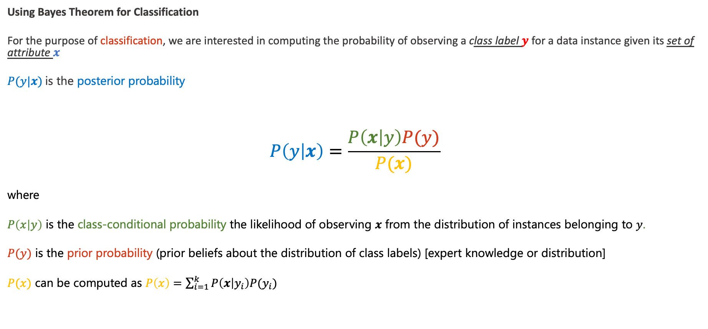
Bayesian Classifiers
Using Bayes Theorem for Classification
For the purpose of classification, we are interested in computing the probability of observing a class label $y$ for a data instance given its set of attribute $x$
$P(y|x)$is the posterior probability
$$P\left(y | x\right)=\frac{P\left(x | y\right)P(y)}{P(x)}$$
where
$P\left(x | y\right)$ is the class-conditional probability the likelihood of observing $x$ from the distribution of instances belonging to $y$.
$P(y)$ is the prior probability (prior beliefs about the distribution of class labels) [expert knowledge or distribution]
$P(x)$ can be computed as $P\left(x\right)=\sum_{i=1}^{k}{P\left(x | y_{i}\right)P(y_{i})}$

Slide 68
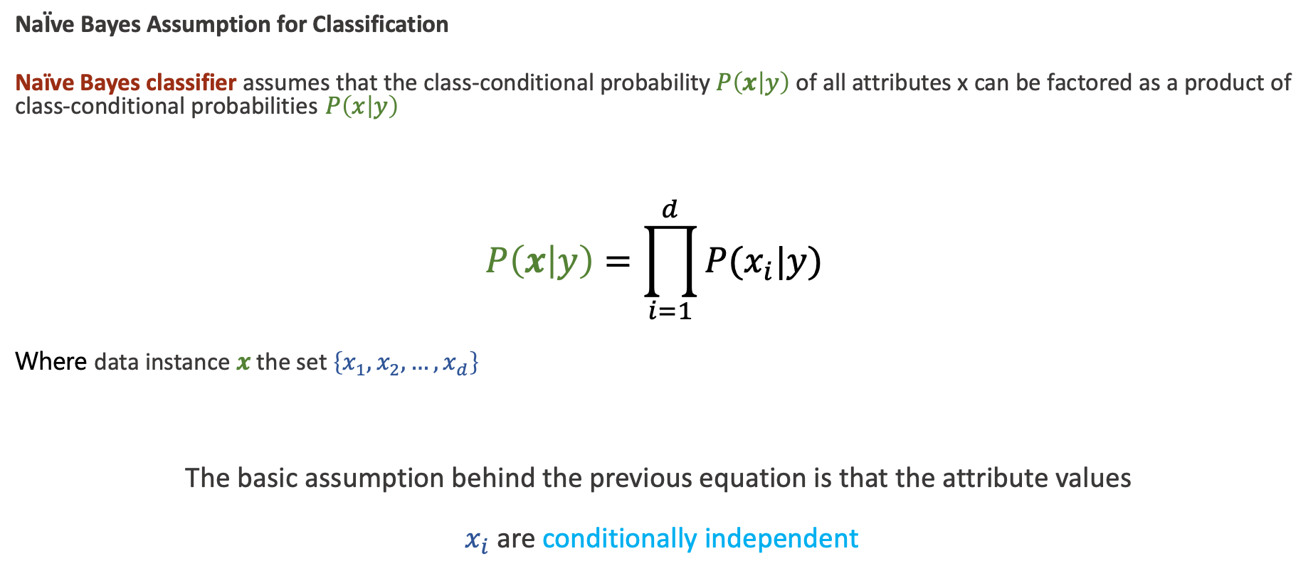
Bayesian Classifiers
NaÏve Bayes Assumption for Classification
Naïve Bayes classifier assumes that the class-conditional probability $P\left(x | y\right)$of all attributes x can be factored as a product of class-conditional probabilities $P\left(x | y\right)$
$$P\left(x | y\right)=\prod_{i=1}^{d}{P(x_{i}|y) }$$
Where data instance $x$ the set $\left\{x_{1},x_{2},…, x_{d}\right\}$
The basic assumption behind the previous equation is that the attribute values
$x_{i}$ are conditionally independent

Slide 69
Bayesian Classifiers
NaÏve Bayes Assumption for Classification
The NaÏve Bayes classifier computes the posterior probability for a test instance $x$ by using the following equation
$$P\left(y | x\right)=P(y)\prod_{i=1}^{d}{P(x_{i}|y) }$$

Slide 70
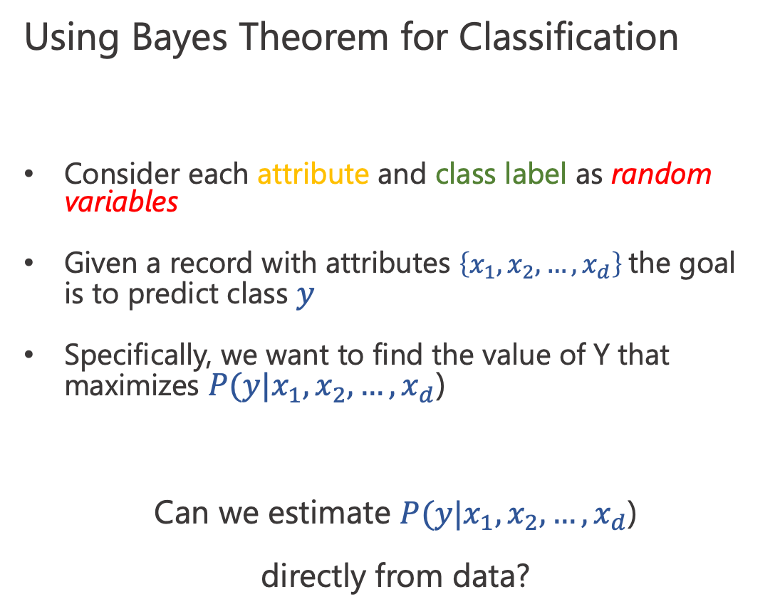
Bayesian Classifiers
Using Bayes Theorem for Classification
Consider each attribute and class label as random variables
Given a record with attributes $\left\{x_{1},x_{2},…, x_{d}\right\}$the goal is to predict class $y$
Specifically, we want to find the value of Y that maximizes $P(y|x_{1},x_{2},…, x_{d}$)
Can we estimate $P(y|x_{1},x_{2},…, x_{d}$)
directly from data?

Slide 71
Bayesian Classifiers: Example
Given a Test Record:
$$P\left(y | x\right)=P(y)\prod_{i=1}^{d}{P(x_{i}|y) }$$
We need to estimate
$P\left(y=yes | x\right)$and $P\left(y=no | x\right)$
In the following we will replace
y = Yes by Yes, and
y = No by No

Slide 72
Bayesian Classifiers: Example
Given a Test Record:
$$P\left(yes | x\right)=P(yes)\prod_{i=1}^{d}{P(x_{i}|yes) }$$
$$P\left(no | x\right)=P(no)\prod_{i=1}^{d}{P(x_{i}|no) }$$

Slide 73
Bayesian Classifiers: Example
Given a Test Record:
$$P\left(yes\right)=3/10$$
$$P\left(no\right)=7/10$$

Slide 74
Bayesian Classifiers: Example
Given a Test Record:
$$\prod_{i=1}^{d}{P(x_{i}|yes) }$$
P(X | Yes) =
P(Refund = No | Yes) x
P(Divorced | Yes) x
P(Income = 120K | Yes)
P(X | No) =
P(Refund = No | No) x
P(Divorced | No) x
P(Income = 120K | No)
$$\prod_{i=1}^{d}{P(x_{i}|no) }$$

Slide 75
Bayesian Classifiers: Example
Given a Test Record:
$$\prod_{i=1}^{d}{P(x_{i}|yes) }$$
P(X | Yes) =
P(Refund = No | Yes) x
P(Divorced | Yes) x
P(Income = 120K | Yes)
P(X | No) =
P(Refund = No | No) x
P(Divorced | No) x
P(Income = 120K | No)
$$\prod_{i=1}^{d}{P(x_{i}|no) }$$
≈
Categorical
Continuous

Slide 76
Bayesian Classifiers: Example
Given a Test Record:
For categorical attributes: $P\left(x_{i}=c | yes\right)=n_{c}/n$ = n_{c}/ n
where $n_c$ is number of instances having attribute value $x_{i}=c$ and belonging to class y
Examples:
P(Status=Married|No) = 4/7 P(Refund=Yes|Yes) = 0

Slide 77
Bayesian Classifiers: Example
For continuous attributes:
Discretization: Partition the range into bins:
Replace continuous value with bin value
Attribute changed from continuous to ordinal
Probability density estimation:
Assume attribute follows a normal distribution
Use data to estimate parameters of distribution (e.g., mean and standard deviation)
Once probability distribution is known, use it to estimate the conditional probability P(X_{i}|Y)

Slide 78
Bayesian Classifiers: Example
Given a Test Record:
Normal distribution:
One for each (X_{i},Y_{i}) pair
For (Income, Class=No):
If Class=No
sample mean = 110
sample variance = 2975

Slide 79
Bayesian Classifiers: Example
Given a Test Record:
Naïve Bayes Classifier:
P(Refund = Yes | No) = 3/7
P(Refund = No | No) = 4/7
P(Refund = Yes | Yes) = 0
P(Refund = No | Yes) = 1
P(Marital Status = Single | No) = 2/7
P(Marital Status = Divorced | No) = 1/7
P(Marital Status = Married | No) = 4/7
P(Marital Status = Single | Yes) = 2/3
P(Marital Status = Divorced | Yes) = 1/3
P(Marital Status = Married | Yes) = 0
For Taxable Income:
If class = No: sample mean = 110
sample variance = 2975
If class = Yes: sample mean = 90
sample variance = 25
P(X | No) = P(Refund=No | No) × P(Divorced | No) × P(Income=120K | No) = 4/7 × 1/7 × 0.0072 = 0.0006
P(X | Yes) = P(Refund=No | Yes) × P(Divorced | Yes) × P(Income=120K | Yes) = 1 × 1/3 × 1.2 × 10⁻⁹ = 4 × 10⁻¹⁰

Slide 80
Bayesian Classifiers: Example
Given a Test Record:
$$P\left(y | x\right)=P(y)\prod_{i=1}^{d}{P(x_{i}|y) }$$
$P\left(no|x\right)=P\left(no\right)$ $P(x|no)\text{=0.0004}$
$P\left(yes|x\right)=P\left(yes\right)$ $P\left(x | yes\right)\text{ = 1.2 }{10}^{−10}$
P(X | No) = P(Refund=No | No) × P(Divorced | No) × P(Income=120K | No) = 4/7 × 1/7 × 0.0072 = 0.0006
P(X | Yes) = P(Refund=No | Yes) × P(Divorced | Yes) × P(Income=120K | Yes) = 1 × 1/3 × 1.2 × 10⁻⁹ = 4 × 10⁻¹⁰
$$P\left(no\right)=7/10$$
$$P\left(yes\right)=3/10$$

Slide 81
Naïve Bayes Classifier can make decisions with partial information about attributes in the test record
Bayesian Classifiers: Issue
Naïve Bayes Classifier:
P(Refund = Yes | No) = 3/7
P(Refund = No | No) = 4/7
P(Refund = Yes | Yes) = 0
P(Refund = No | Yes) = 1
P(Marital Status = Single | No) = 2/7
P(Marital Status = Divorced | No) = 1/7
P(Marital Status = Married | No) = 4/7
P(Marital Status = Single | Yes) = 2/3
P(Marital Status = Divorced | Yes) = 1/3
P(Marital Status = Married | Yes) = 0
For Taxable Income:
If class = No: sample mean = 110
sample variance = 2975
If class = Yes: sample mean = 90
sample variance = 25
P(Yes) = 3/10 P(No) = 7/10
If we only know that marital status is Divorced, then:
P(Yes | Divorced) = 1/3 x 3/10 / P(Divorced)
P(No | Divorced) = 1/7 x 7/10 / P(Divorced)
If we also know that Refund = No, then
P(Yes | Refund = No, Divorced) = 1 x 1/3 x 3/10 P(Divorced, Refund = No)
P(No | Refund = No, Divorced) = 4/7 x 1/7 x 7/10 P(Divorced, Refund = No)
If we also know that Taxable Income = 120, then
P(Yes | Refund = No, Divorced, Income = 120) = 1.2 x10⁻⁹ x 1 x 1/3 x 3/10 P(Divorced, Refund = No, Income = 120 )
P(No | Refund = No, Divorced Income = 120) = 0.0072 x 4/7 x 1/7 x 7/10 P(Divorced, Refund = No, Income = 120)

Slide 82
Bayesian Classifiers: Issue
Given a Test Record:
X = (Married)
Naïve Bayes Classifier:
P(Refund = Yes | No) = 3/7
P(Refund = No | No) = 4/7
P(Refund = Yes | Yes) = 0
P(Refund = No | Yes) = 1
P(Marital Status = Single | No) = 2/7
P(Marital Status = Divorced | No) = 1/7
P(Marital Status = Married | No) = 4/7
P(Marital Status = Single | Yes) = 2/3
P(Marital Status = Divorced | Yes) = 1/3
P(Marital Status = Married | Yes) = 0
For Taxable Income:
If class = No: sample mean = 110
sample variance = 2975
If class = Yes: sample mean = 90
sample variance = 25
P(Yes) = 3/10
P(No) = 7/10
P(Yes | Married) = 0 x 3/10 / P(Married)
P(No | Married) = 4/7 x 7/10 / P(Married)

Slide 83
Bayesian Classifiers: Issue
Consider the table with Tid = 7 deleted
Naïve Bayes Classifier:
P(Refund = Yes | No) = 2/6
P(Refund = No | No) = 4/6
P(Refund = Yes | Yes) = 0
P(Refund = No | Yes) = 1
P(Marital Status = Single | No) = 2/6
P(Marital Status = Divorced | No) = 0
P(Marital Status = Married | No) = 4/6
P(Marital Status = Single | Yes) = 2/3
P(Marital Status = Divorced | Yes) = 1/3
P(Marital Status = Married | Yes) = 0/3
For Taxable Income:
If class = No: sample mean = 91
sample variance = 685
If class = No: sample mean = 90
sample variance = 25
Given X = (Refund = Yes, Divorced, 120K)
P(X | No) = 2/6 X 0 X 0.0083 = 0
P(X | Yes) = 0 X 1/3 X 1.2 X 10⁻⁹ = 0
Naïve Bayes will not be able to classify X as Yes or No!

Slide 84
Bayesian Classifiers: Issue
If one of the conditional probabilities is zero, then the entire expression becomes zero
Need to use other estimates of conditional probabilities than simple fractions
Probability estimation:
n: number of training instances belonging to class y
n_{c}: number of instances with X_{i} = c and Y = y
v: total number of attribute values that X_{i} can take
p: initial estimate of (P(X_{i} = c|y) known apriori
m: hyper-parameter for our confidence in p
$$original: P\left(X_{i}=c\right|y)=\frac{n_{c}}{n}$$
$$Laplace Estimate: P\left(X_{i}=c\right|y)=\frac{n_{c}+1}{n+v}$$
$$m−estimate: P\left(X_{i}=c\right|y)=\frac{n_{c}+mp}{n+m}$$

Slide 85
Bayesian Classifiers: Issue
Robust to isolated noise points
Handle missing values by ignoring the instance during probability estimate calculations
Robust to irrelevant attributes
Redundant and correlated attributes will violate class conditional assumption
Use other techniques such as Bayesian Belief Networks (BBN)

Slide 86

Bayesian Classifiers
Support Vector Machines

Slide 87
Support Vector Machines
A support vector machine (SVM) is a discriminative classification model that learns linear or nonlinear decision boundaries in the attribute space to separate the classes.
SVM
strong regularization capabilities.
good generalization performance.
learn highly expressive models without suffering from overfitting.
Find a linear hyperplane (decision boundary) that will separate the data

Slide 88
Support Vector Machines
A support vector machine (SVM) is a discriminative classification model that learns linear or nonlinear decision boundaries in the attribute space to separate the classes.
SVM
strong regularization capabilities.
good generalization performance.
learn highly expressive models without suffering from overfitting.
One Possible Solution

Slide 89
Support Vector Machines
A support vector machine (SVM) is a discriminative classification model that learns linear or nonlinear decision boundaries in the attribute space to separate the classes.
SVM
strong regularization capabilities.
good generalization performance.
learn highly expressive models without suffering from overfitting.
Another Possible Solution

Slide 90
Support Vector Machines
A support vector machine (SVM) is a discriminative classification model that learns linear or nonlinear decision boundaries in the attribute space to separate the classes.
SVM
strong regularization capabilities.
good generalization performance.
learn highly expressive models without suffering from overfitting.
Other Possible Solutions

Slide 91
Support Vector Machines
A support vector machine (SVM) is a discriminative classification model that learns linear or nonlinear decision boundaries in the attribute space to separate the classes.
SVM
strong regularization capabilities.
good generalization performance.
learn highly expressive models without suffering from overfitting.
Which one is better? B1 or B2?
How do you define better?

Slide 92
Support Vector Machines
The point is now about the margin of a separating hyperplane and the rationale for choosing such a hyperplane with maximum margin.
Find hyperplane maximizes the margin
B1 is better than B2

Slide 93
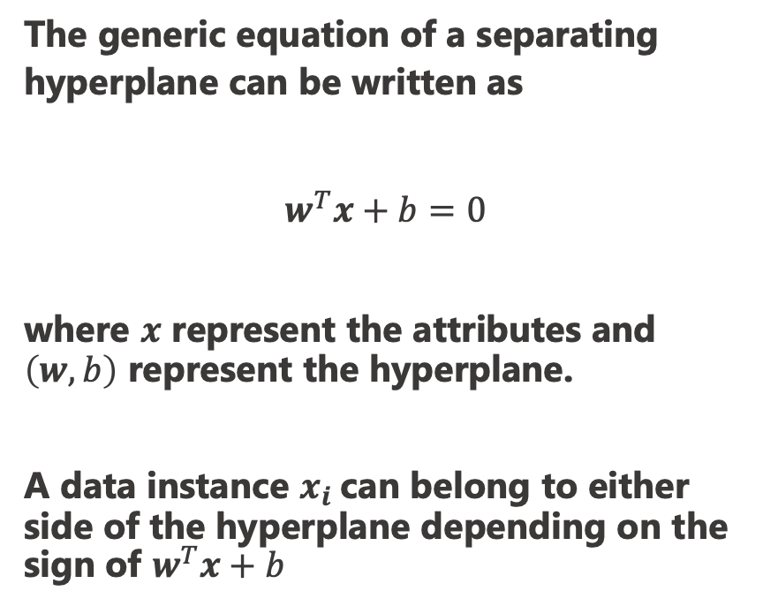
Support Vector Machines
The generic equation of a separating hyperplane can be written as
$$w^{T}x+b=0$$
where $x$ represent the attributes and $\left(w,b\right)$ represent the hyperplane.
A data instance $x_{i}$can belong to either side of the hyperplane depending on the sign of $w^{T}x+b$

Slide 94
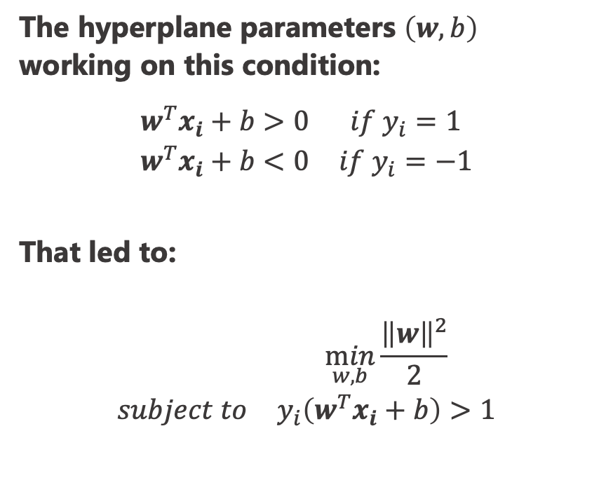
Support Vector Machines
The hyperplane parameters $\left(w,b\right)$ working on this condition:
$$\begin{matrix}w^{T}x_{i}+b>0 & if y_{i}=1 \\ w^{T}x_{i}+b<0 & if y_{i}=−1\end{matrix}$$
That led to:
$$\begin{matrix} & \min_{w,b}{\frac{{\left\|w\right\|}^{2}}{2}} \\ subject to & y_{i}\left(w^{T}x_{i}+b\right)>1\end{matrix}$$

Slide 95
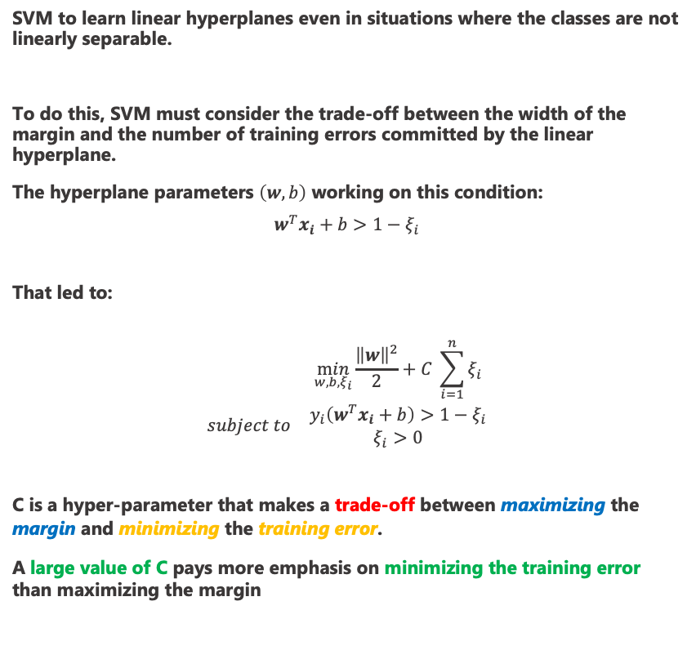
Support Vector Machines
SVM to learn linear hyperplanes even in situations where the classes are not linearly separable.
To do this, SVM must consider the trade-off between the width of the margin and the number of training errors committed by the linear hyperplane.
The hyperplane parameters $\left(w,b\right)$ working on this condition:
$$w^{T}x_{i}+b>1−ξ_{i}$$
That led to:
$$\begin{matrix} & \min_{w,b,ξ_{i}}{\frac{{\left\|w\right\|}^{2}}{2}}+C \sum_{i=1}^{n}{ξ_{i}} \\ subject to & \begin{aligned}y_{i}\left(w^{T}x_{i}+b\right)>1−ξ_{i} \\ ξ_{i}>0\end{aligned}\end{matrix}$$
C is a hyper-parameter that makes a trade-off between maximizing the margin and minimizing the training error.
A large value of C pays more emphasis on minimizing the training error than maximizing the margin

Slide 96
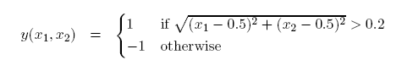
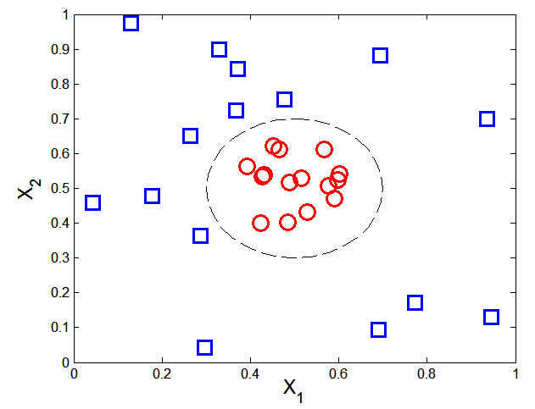

Nonlinear Support Vector Machines
What if decision boundary is not linear?
A nonlinear transformation$φ$is needed to map the data from its original attribute space into a new linear separable space
Transform the data from its original attribute space in $x$ into a new space $φ(x)$ so that a linear hyperplane
Learned hyperplane can then be projected back to the original attribute space, resulting in a nonlinear decision boundary.

Slide 97


Nonlinear Support Vector Machines
The transformation required is:
$φ:(x_{1},x_{2})→(x_{1}^{2}−x_{1},x_{2}^{2}−x_{2})$

Slide 98


Nonlinear Support Vector Machines
Learning not linear model
The new decision boundary is:
$$w^{T}{φ(x}_{i})+b =0$$
that results in the new learning
$$\begin{matrix} & \min_{w,b,ξ_{i}}{\frac{{\left\|w\right\|}^{2}}{2}}+C \sum_{i=1}^{n}{ξ_{i}} \\ subject to & \begin{aligned}y_{i}\left(w^{T}{φ(x}_{i})+b\right)>1−ξ_{i} \\ ξ_{i}>0\end{aligned}\end{matrix}$$
W$e need only inner products of φ(x)$
What type of mapping function $φ$ should be used?
How to do the computation in high dimensional space?

Slide 99


Learning Nonlinear SVM
The kernel trick is a method for computing this similarity as a function of the original attribute
$$K\left(u,v\right)=\left\langle φ\left(u\right),φ(v)\right\rangle =f(u,v)$$
where f() is a function that follows certain conditions as stated by the Mercer’s Theorem
By using a kernel function, we can directly work with inner products in the transformed space without dealing with the exact forms of the nonlinear transformation function
High-dimensional transformations, performing calculations only in the original attribute space

Slide 100

Example of Nonlinear SVM
SVM with polynomial degree 2 kernel

Slide 101

Learning Nonlinear SVM
Advantages of using kernel:
Don’t have to know the mapping function $φ$
Computing dot product $\left\langle φ\left(u\right),φ(v)\right\rangle$ in the original space avoids curse of dimensionality
Not all functions can be kernels
Must make sure there is a corresponding Φ in some high-dimensional space
Mercer’s theorem (see textbook)

Slide 102
Characteristics of SVM
Robust to noise
Overfitting is handled by maximizing the margin of the decision boundary,
SVM can handle irrelevant and redundant attributes better than many other techniques
The user needs to provide the type of kernel function and cost function
Difficult to handle missing values

Slide 103

Ensemble Techniques

Slide 104

Ensemble Methods
Construct a set of base classifiers learned from the training data
Predict class label of test records by combining the predictions made by multiple classifiers (e.g., by taking majority vote)
Combination rule
Prediction

Slide 105

General Approach of Ensemble Learning
The ensemble of classifiers can be constructed in many ways:
By manipulating the training set
By manipulating the input features
By manipulating the class labels
By manipulating the learning algorithm
The first three approaches are generic methods that are applicable to any classifier, whereas the fourth approach depends on the type of classifier used.
Using majority vote or weighted majority vote
(weighted according to their accuracy or relevance)
$$C (x)=f(C_{1}(x),C_{2}(x),...,C_{k}(x))$$

Slide 106

Example: Why Do Ensemble Methods Work?

Slide 107

Necessary Conditions for Ensemble Methods
Ensemble Methods work better than a single base classifier if:
All base classifiers are independent of each other
All base classifiers perform better than random guessing (error rate < 0.5 for binary classification)
Classification error for an ensemble of 25 base classifiers, assuming their errors are uncorrelated.

Slide 108
Rationale for Ensemble Learning
Ensemble Methods work best with unstable base classifiers
Classifiers that are sensitive to minor perturbations in training set, due to high model complexity
Examples: Unpruned decision trees, ANNs, …

Slide 109

Bias-Variance Decomposition
Bias-variance decomposition is a formal method for analyzing the generalization error of a predictive model
Noise term is intrinsic to the target class
Bias and Variance terms depend on the choice of the classification model
Bias of a model represents how close the average prediction of the model is to the average target
Variance of a model captures the stability of its predictions
For classification, the generalization error of model $m$ can be given by:
$$gen.error\left(m\right)=c_{1}+bias\left(m\right)+c_{2}×variance(m)$$

Slide 110
Bias-Variance Trade-off and Overfitting
Ensemble methods try to reduce the variance of complex models (with low bias) by aggregating responses of multiple base classifiers (even help in reducing the bias)
Low bias but high variance, it can become susceptible to overfitting,
Bias-Variance trade-off can be used to explain why ensemble learning improves the generalization performance of unstable classifiers
Overfitting
Underfitting

Slide 111
Bagging (Bootstrap AGGregatING)
Bagging (AKA bootstrap aggregating), is a technique that repeatedly samples (with replacement) from a data set according to a uniform probability distribution
Each bootstrap sample has the same size as the original data
Some instances may appear several times in the same training set
Probability of a training instance being selected in a bootstrap sample is:
1 – (1 - 1/n)^{n} (n: number of training instances)
~0.632 when n is large
Build classifier on each bootstrap sample

Slide 112
Bagging Algorithm

Slide 113
Bagging Example
Consider 1-dimensional data set:
Classifier is a decision stump (decision tree of size 1)
Decision rule: x ≤ k versus x > k
Split point k is chosen based on entropy
x ≤ k
True
False
y_{left}
y_{right}

Slide 114
Bagging Example

Slide 115
Bagging Example
Summary of Trained Decision Stumps:

Slide 116
Bagging Example
Use majority vote (sign of sum of predictions) to determine class of ensemble classifier
Bagging can also increase the complexity (representation capacity) of simple classifiers such as decision stumps
Predicted Class

Slide 117
Bagging Example
Use majority vote (sign of sum of predictions) to determine class of ensemble classifier
Bagging can also increase the complexity (representation capacity) of simple classifiers such as decision stumps
Predicted Class

Slide 118
Bagging Example
Use majority vote (sign of sum of predictions) to determine class of ensemble classifier
Bagging can also increase the complexity (representation capacity) of simple classifiers such as decision stumps
Predicted Class
Predicted Class

Slide 119
Boosting
Boosting is an iterative procedure used to adaptively change the distribution of training examples for learning base classifiers so that they increasingly focus on examples that are hard to classify
Boosting assigns a weight to each training example and may adaptively change the weight at the end of each boosting round
1. They can be used to inform the sampling distribution used to draw a set of bootstrap samples from the original data.
2. They can be used to learn a model that is biased toward examples with higher weight.
Examples that are classified incorrectly will have their weights increased, while those that are classified correctly will have their weights decreased
This forces the classifier to focus on examples that are difficult to classify in subsequent iterations

Slide 120



AdaBoost
Consider a dataset $\{(x_{i}, y_{i})|j=1,2,…,N\}$
In Adaboost the importance of a classifier $C_{i}$ depends on the error rate :
The importance of a base classifier is given by

Slide 121


AdaBoost Algorithm
Weight update:
If any intermediate rounds produce error rate higher than 50%, the weights are reverted back to 1/n and the resampling procedure is repeated

Slide 122
AdaBoost Algorithm

Slide 123
AdaBoost Example
Consider 1-dimensional data set:
Classifier is a decision stump (decision tree of size 1)
Decision rule: x ≤ k versus x > k
Split point k is chosen based on entropy
x ≤ k
True
False
y_{left}
y_{right}

Slide 124
AdaBoost Example
Training sets for the first 3 boosting rounds:
Weights

Slide 125
AdaBoost Example
Alpha
Classification
Predicted Class

Slide 126
Random Forest Algorithm
Construct an ensemble of decision trees by manipulating training set as well as features
Use bootstrap sample to train every decision tree (similar to Bagging)
Use the following tree induction algorithm:
At every internal node of decision tree, randomly sample p attributes for selecting split criterion
Repeat this procedure until all leaves are pure (unpruned tree)

Slide 127
Random Forest Algorithm
Construct an ensemble of decision trees by manipulating training set as well as features
Base classifier are unpruned trees and hence are unstable classifier
Base classifier are uncorrelated (due to randomization in training and features)
Random forest reduce variance of unstable classifier without impacting the bias

